Slide 1
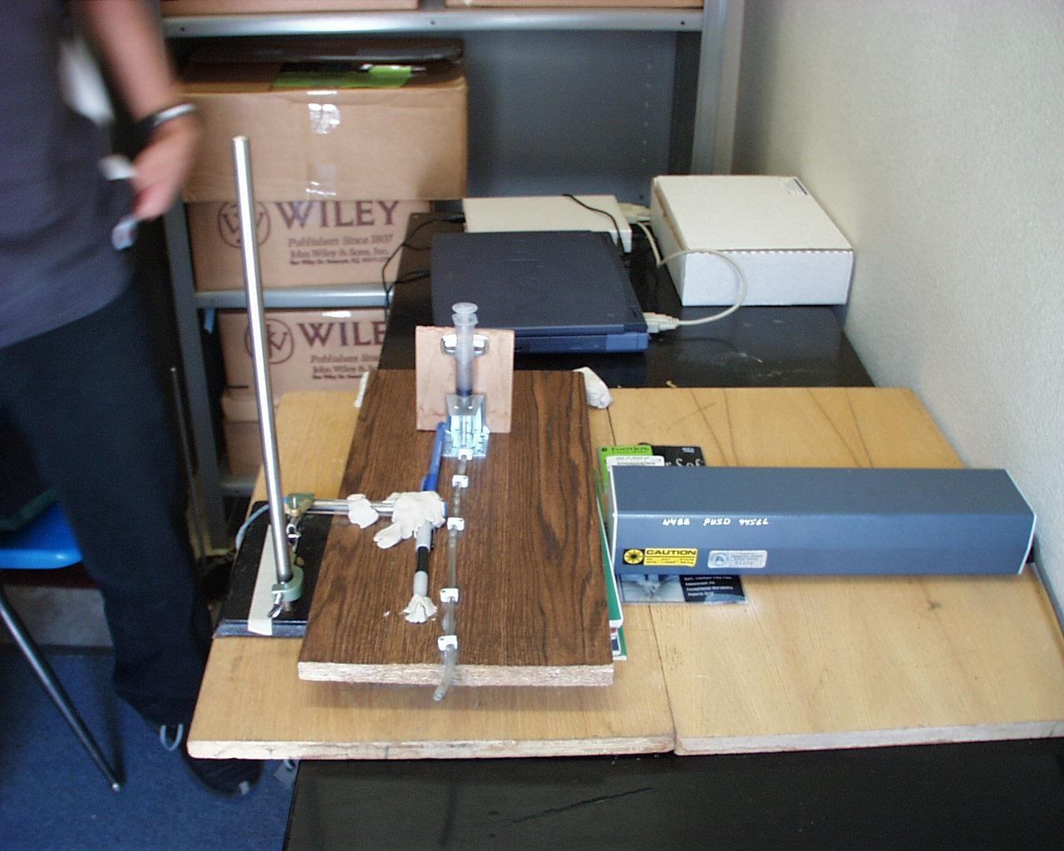
SIZE DOES MATTER
By: Amar Bhatti & Richard Wu

Slide 2

WHAT IS BIOTERRORISM?
Bioterrorism is the overt or covert dispensing of disease pathogens by individuals, groups, or governments for the expressed purpose of causing harm for either ideological, political, or financial gain.

Slide 3
DEADLY PATHOGENS
Smallpox is a highly contagious, untreatable virus. Wild smallpox was eradicated decades ago, but the Soviet Union and others experimented with turning laboratory supplies of smallpox virus into bioweapons, so the virus still exists. If the virus was used by terrorists, the world would be vulnerable because no one has been vaccinated in decades. Vaccine a few days after exposure to smallpox can protect, but there are only 6-7 million doses left in the United States.
Anthrax is more deadly if people inhale the germ spores -- 80 percent of the infected die -- and is believed more readily available than smallpox. But the infection is not spread person-to-person like smallpox. The military is getting vaccinated, but there isn't enough for civilians. However, antibiotics given before symptoms appear can prevent disease.

Slide 4
What are we doing about this problem?
Right not in terms of military defense, the United States has granted 158 million dollars to be spent on projects gearing us for protection from these deadly attacks. Lawrence Livermore National Laboratory have been conducting projects on this and the traditional method has been to use fluorescent dyes in identifying diseases. However in a national epidemic, time is limited and although this technique may be efficient, results are needed faster in order to evacuate areas where many individuals may be working (e.g. post office, or even school rooms)

Slide 5
Ideas for Solutions…
Many pathogens, including anthrax and smallpox, can be spread through the air. However, these airborne pathogens can be removed by filtering the air, making the task of a bioterrorist more difficult and less rewarding. A simpler idea that has grown in popularity is the use of lasers, a much more efficient and faster way in identifying pathogens such as anthrax, thus where our project comes to play…SIZE DOES MATTER!

Slide 6
What is Particle Scattering?
Theory:
All materials scatter light in a certain direction whether it is in a solid, liquid or gaseous state. This scattering involves the release of photons by a material when it is hit with a beam of light. The release of photons dominate the principles diffraction and refraction.
Mie’s theory says that scattering is greatly affected by size and shape. The bigger the particle the more light will be scattered in a forward direction. The same goes for a rougher surface. The smaller and smoother the particle the greater the tendency for equal scatter in all directions. (isotropic)

Slide 7
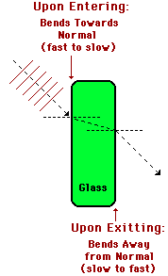
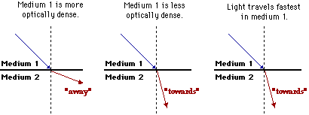
Different types of Scattering
Refraction:
Refraction is the tendency for light to bend in different directions when going through different mediums. This behavior is mainly controlled by density. The best environment for refraction would be in a vacuum.
Diffraction:
This is the tendency for light to bend around a barrier. This behavior is controlled by the size of the barrier.

Slide 8
Goals for this experiment
Question
Can particle scattering allow us to differentiate between bacteria?
Hypothesis
We believe that particle scattering is a building block that can lead us to differentiating between different substrates (particle scattering itself cannot allow us to separate living and nonliving things, but it is a stepping stone into that direction. Further addition in areas such as bioluminescence for example, can perhaps lead to a discovery of identifying pathogenic materials that may be around us.)
Prediction
If particle scattering can differentiate particle shapes and sizes of inanimate objects, then it should be a practical method in differentiating living organisms

Slide 9
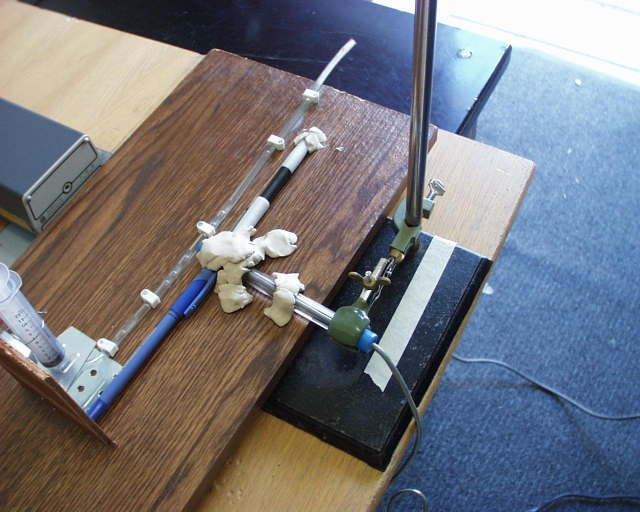
Experimental Set Up

Slide 10
GRAPHS ON SUBSTRATES
1) Each substrate that we used had four trials.
2) We made a run for each substrate --a collection period of 10 seconds was timed. (we had a 450 gram weight placed ontop of each of the substrates when making runs.
3) Based on our prediction we were looking for higher intensities for bigger particles. Each particle as mentioned before released photons therefore the measurements were made in LUX. We also compared the mean for each of the four runs.

Slide 11
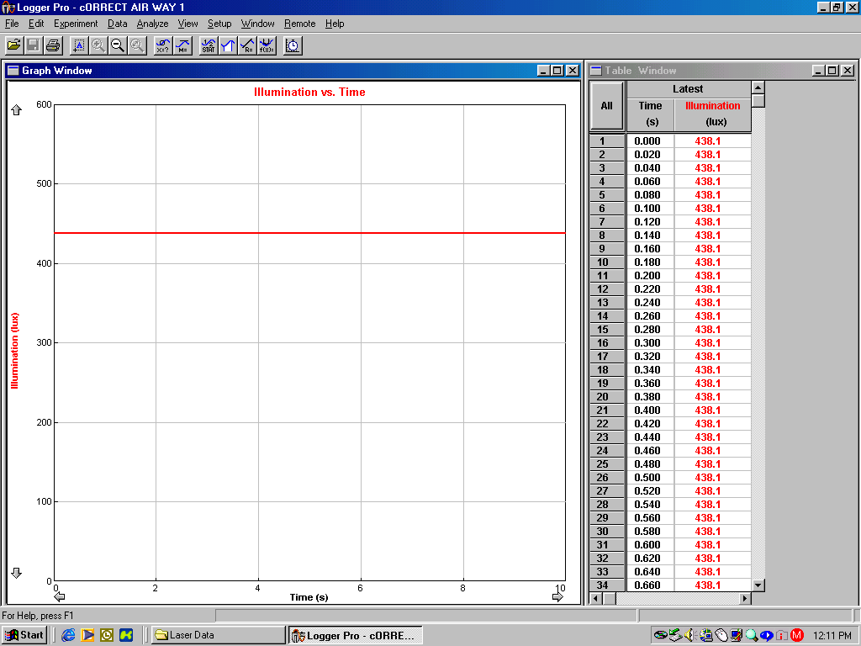
Air Reading

Slide 12
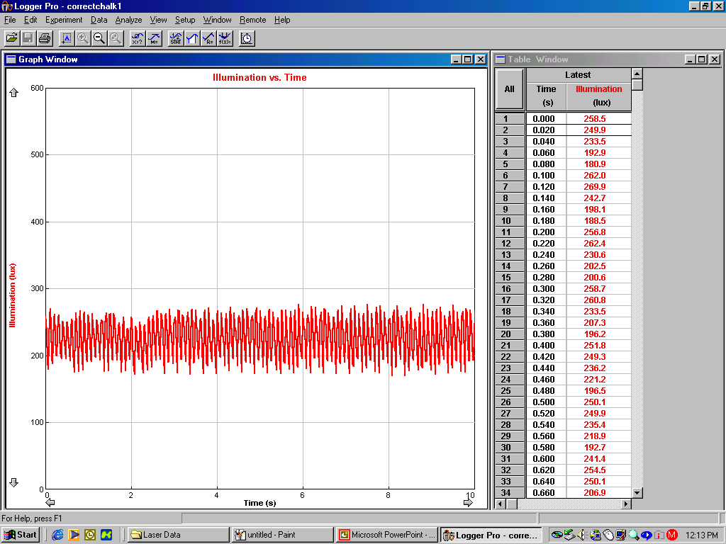
Substrate 1: Chalk

Slide 13
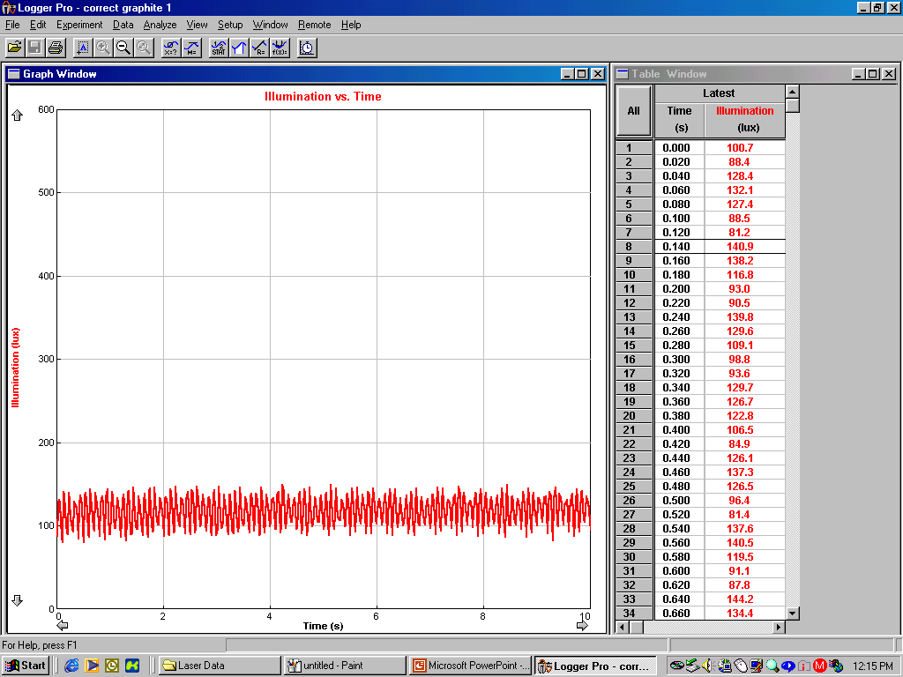
Substrate 2: Graphite

Slide 14
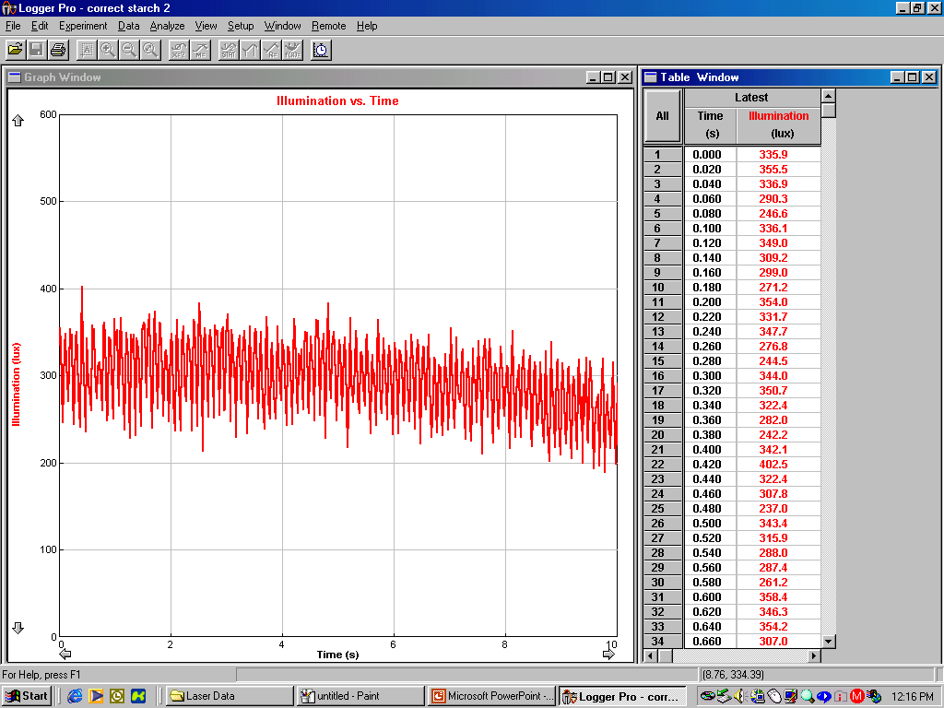
Substrate 3: Corn Starch

Slide 15
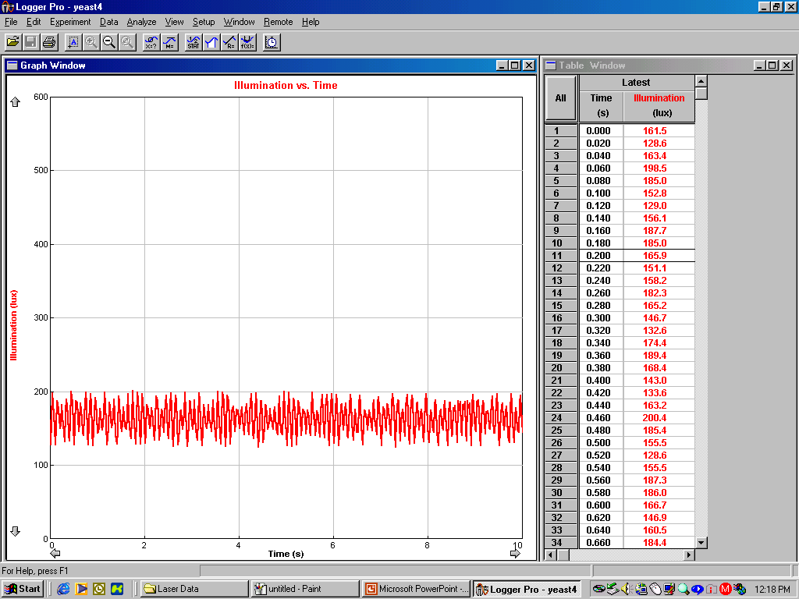
Living Substrate: Yeast

Slide 16
Conclusion
After the analysis of our data there are many things that support our prediction, however there is also room that may question the validity of our results. Much of this error has come from the lack of specificity in our methodology which has hindered our results severely. So yes particle scattering can be used to identify pathogens, however it is not the only key to this complex puzzle…

Slide 17
Problems with Experiment
1) The first problem with the experiment was that we did not make a homogenous mixture. Meaning the sizes of all the particles were not all exactly the same. We also didn’t make equal molarities of each solution.
2) We only took one angle
3) We took the 180 degree angle
4) The detector sometimes got saturated.
5) Sound interference (Electric interference coming from Weather Station)
6) Plunger got contaminated
7) Clogging of taigon tubing
8) Rate the plunger fell
9) Keeping a constant angle
10) Keeping the laser a constant distance and angle
11) Temperature on each day

Slide 18
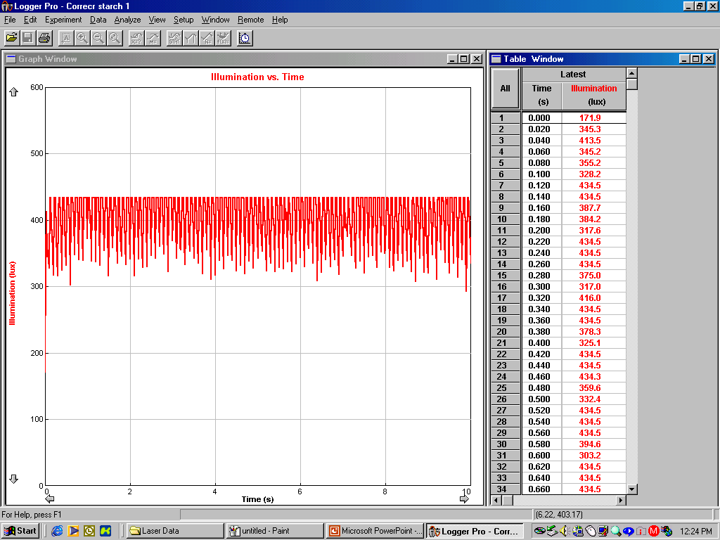
Saturation

Slide 19
Improvements
1) GET RID OF ERRORS
2) Couple it with a biotrace luminescence
3) Make an automated system
4) Explore further characteristics of cells. E.G. Different membranes react differently to different wavelengths of light.
http://www.protein-solutions.com/ms.htmhttp://www.protein-solutions.com/ms.htmhttp://www.biotrace.co.uk/index.cfm/application/frameset/product/menustyle=product

